Slide 1


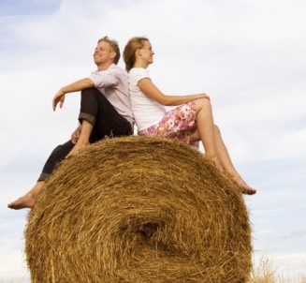

2
Unit 4 Section A
Dance with Love
FOREIGN LANGUAGE TEACHING AND RESEARCH PRESS
AIR FORCE ENGINEERING UNIVERSITY
Notes:
1

Slide 2
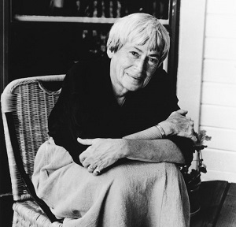
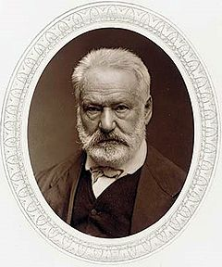
2
4
UNIT
Love doesn’t just sit there, like a stone; it has to be made, like bread, remade all the time, made new.
— Ursula K. Le Guin
The greatest happiness of life is the conviction that we are loved – loved for ourselves, or rather, loved in spite of ourselves.
— Victor Hugo
Notes:
2

Slide 3

^{Section A}
2
4
Dance with love
UNIT
College sweethearts
To talk about romantic love
Objectives
To understand the text fully
To apply the phrases and patterns
To master the essay writing skill

Slide 4





College sweethearts
Section A
Contents
Warming-up activities
Text study
Language application
Summary

Slide 5



College sweethearts
Section A
Warming-up activities
Lead-in
Pre-reading activities
Cultural background

Slide 6

Lead-in
Look at the pictures and discuss
Look at the following pictures and discuss what are the modern dating practices.
Casual dating

Slide 7

Lead-in
Look at the pictures and discuss
Formal dating

Slide 8
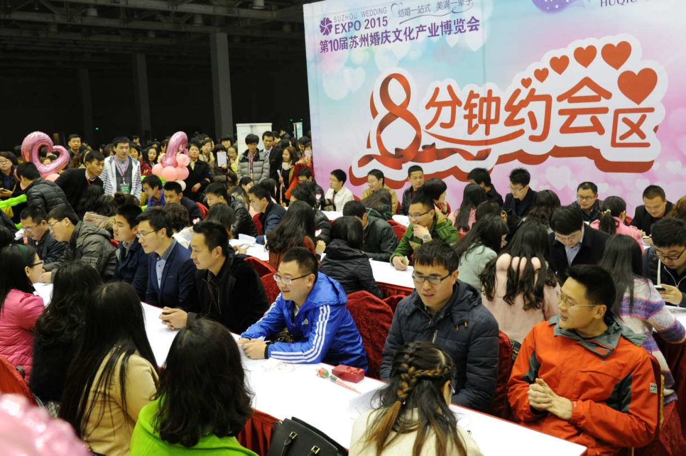
Lead-in
Look at the pictures and discuss
Speed dating

Slide 9
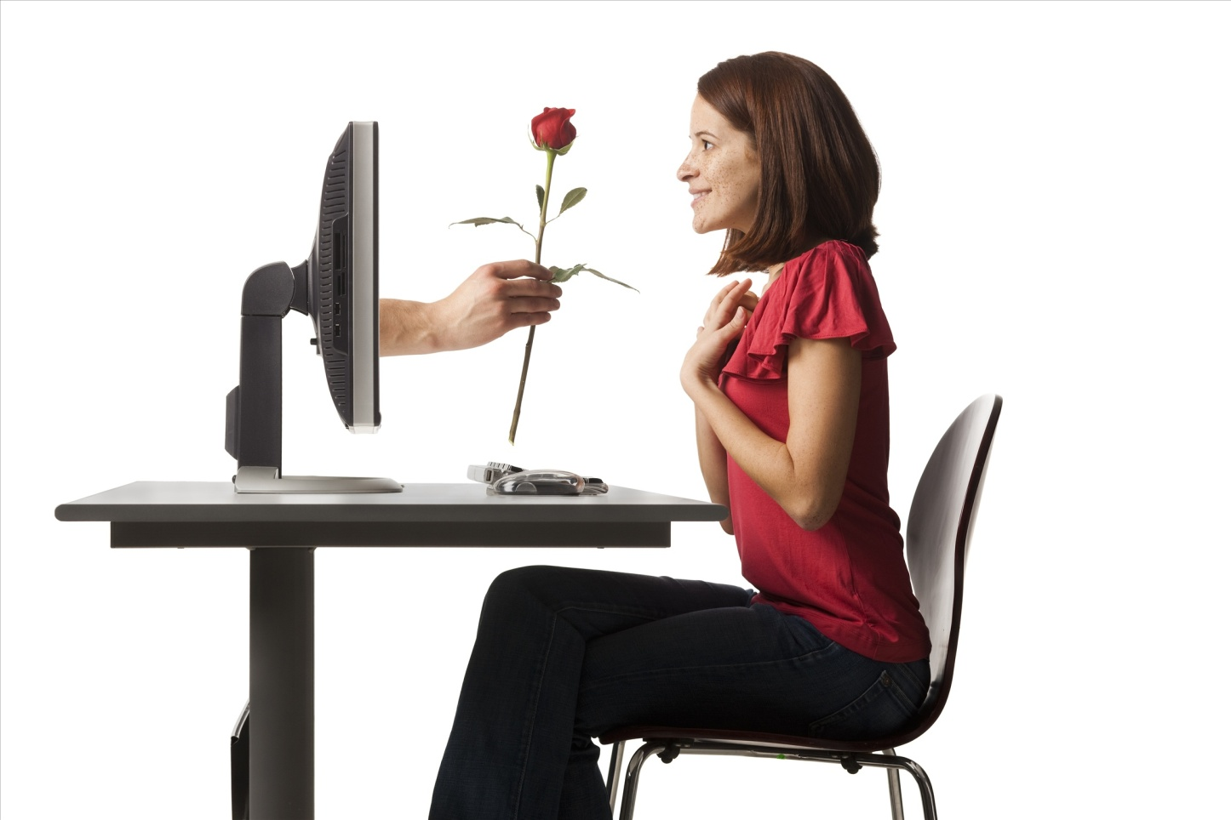
Lead-in
Look at the pictures and discuss
Online dating

Slide 10
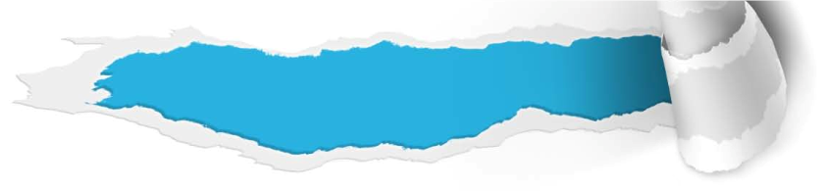
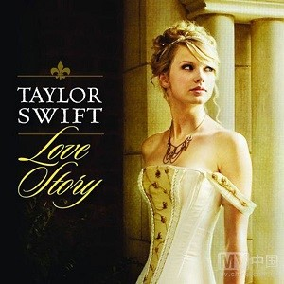



Pre-reading activities
Watch and talk
Watch the MV Love Story sung by Taylor Swift and discuss the following questions.
1. What love story does Taylor Swift tell in the song? And what do you learn?
Tips
2. Do you think it’s a good idea to date someone at college? Why or why not?
Tips
Enjoy an MV

Slide 11


Pre-reading activities
Watch and talk

Slide 12
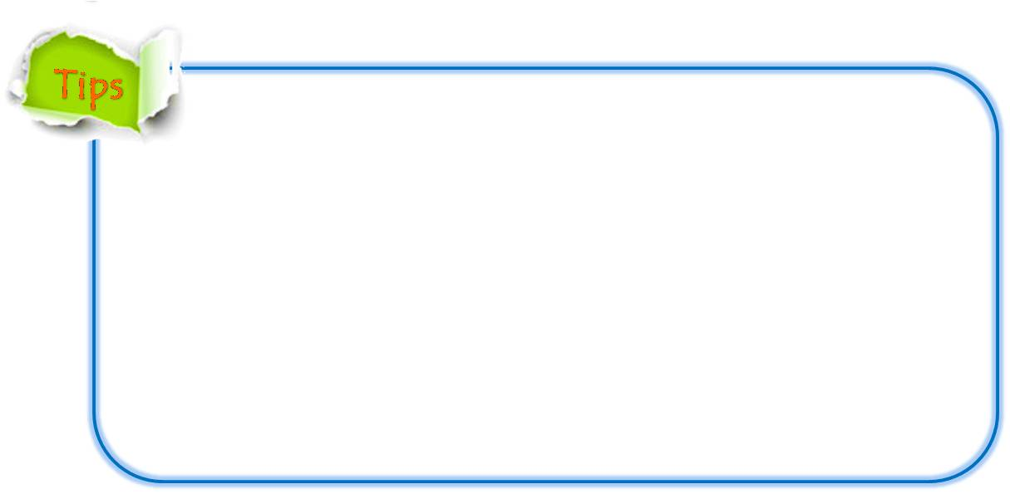
Pre-reading activities
Watch and talk
1. What love story does Taylor Swift tell in the song? And what do you learn?
A love story of Romeo and Juliet who met with strong resistance from their parents because of a family feud, but earned a happy ending with their true love and courage to fight against fate.
Love sometimes is difficult, but as long as we persist and fight for it, we will end up with a happy life.

Slide 13
Pre-reading activities
Watch and talk
2. Do you think it’s a good idea to date someone at college? Why or why not?
Yes, because:
• it’s an ideal place to find someone who has the same aspirations.
• through years of studying together, students get to know each other well.
• college has more choices than the workplace.
• love starting on campus is romantic and pure.

Slide 14
Pre-reading activities
Watch and talk
2. Do you think it’s a good idea to date someone at college? Why or why not?
• No, because students need to concentrate on study, not to waste time dating.

Slide 15


Pre-reading activities
Compound dictation
Listen to a short passage concerning American dating and fill in the missing information.
Before marriage, younger Americans date each other, that is, they often go out together. Casual dating usually begins in the early teens, and in the late teens a _______ of steady dating develops. There is a great _________ that one goes to a dance with one person, to a football game with another, and to a picnic with a third.
pattern
possibility
To be continued

Slide 16
Pre-reading activities
Compound dictation
Listen to a short passage concerning American dating and fill in the missing information.
Sometimes two couples go out together. This is known as “ ______ dating”. Group dating is also ________ among young people. Large groups of boys and girls may _________ together. Young people may go out together for a long time, which is, ________, a public statement of their ________ to marry. Men and women go out together ___________ especially those in cities.
double
popular
go around
in effect
intention
a great deal
To be continued

Slide 17
Pre-reading activities
Compound dictation
Listen to a short passage concerning American dating and fill in the missing information.
This is “adult dating”. They ski together, dine together, either at restaurants or in each other’s homes. The American dating _______ is a rather casual one. Often young Americans who hardly know each other go out on dates. It is also __________ for them to arrange a “blind date”, that is, a date between two young people who have not met before.
system
acceptable

Slide 18

Cultural background
American society in 1960s
Questions Previewing
1. What is the main feature of American society in 1960s?
Tips
2. What is “sexual revolution”?
Tips
3. What happened on American college campus at that time?
Tips

Slide 19


Cultural background
American society in 1960s
What is the main feature of American society in 1960s?
A period of profound societal change;
The urge to “find oneself”, the activism, the quest for autonomy were characterized by changes toward sexual attitudes and practices, particularly among the young.

Slide 20
Cultural background
American society in 1960s
2. What is “sexual revolution”?
The changes to sexual attitudes and behavior during the 1960s are often referred to as the “sexual revolution”;
The sexual revolution was often seen to have been centered on the university campus, among students.

Slide 21
Cultural background
American society in 1960s
3. What was the real situation on American college campus at that time?
Even in the “liberal” 1960s, conservative and traditionalist views were widely held;
Quite many college students were actually following a more traditional pattern of dating, romantic but conservative, a clear stream on campus in the 1960s.

Slide 22

College sweethearts
Section A
Text study
Main idea & structure
Language focus
Critical thinking

Slide 23

Main idea & structure
Main ideas of the parts
This text is a ________ that tells _______________ about the author herself.
narrative
a romantic story
The author’s two daughters are at the age of ______. (Para.1)
dating
What do they think of their parents’ love story? (Para.1)
Tips
They believe it was a classic fairytale romance heading for marriage from the outset.

Slide 24
Main idea & structure
Main ideas of the parts
Does the author hold the same opinion as her daughters’? Why? (Para.1)
Tips
No. The author thinks it’s not completely true. Because she started dating Butch just to get a cute boyfriend, not for love.
Notes:
24

Slide 25

Main idea & structure
Main ideas of the parts
Part I — (Para. 1)
This part is the introduction which prepares for the topic of love. The narrator now has two daughters who are________________. They believe that their parents had a romantic story _________________ from the very beginning. However, It’s not completely true. She started dating Butch not _______ but for fun because she wanted to get away from her boring college life.
at the age of dating
heading for marriage
for love

Slide 26
Main idea & structure
Main ideas of the parts
First date (Para. 2)
Butch’s feeling about the author
The author’s attitude toward Butch
He thought the author had ____________ and he kept ________ her all night long. So, for him, it was ______________.
She was merely ______ and wasn’t that interested because he looked like ________ and seemed a little_____.
beautiful eyes
curious
staring at
a wild boy
love at first sight
weird
Notes:
26

Slide 27
Main idea & structure
Main ideas of the parts
After the first date (Para. 3)
Butch’s action
Author’s response
ride his bicycle past the dorm “by accident”;
pretend to be surprised to see her.
be cautious about his wild personality;
Fear came over her when she started to fall in love.

Slide 28
Main idea & structure
Main ideas of the parts
For what did the author fall in love with Butch? (Para.3)
Tips
For his exciting “bad boy image” was just
too tempting to resist.
What was her real reason to find a boyfriend? (Para.3)
Tips
To add fun to her boring college life.

Slide 29
Main idea & structure
Main ideas of the parts
Why did the author feel worried? (Para.4)
Tips
Because they lived in a time when a dramatic shift in sexual attitudes was taking place, but she was a traditional girl.

Slide 30
Main idea & structure
Main ideas of the parts
One night (Para. 4-5)
Butch
Author
He __________ to the world that the author was his girlfriend and ________ to marry her and become a lawyer.
announced
The author _______ ________ him, but she thought she ’d never marry this guy, a _____ without a good future. She dated him just for ___.
went along with
promised
rebel
fun

Slide 31

Main idea & structure
Main ideas of the parts
One month later (Para. 6-7)
What happened to Butch?
What did the author do for him?
What’s the result?
Tips
failed all his courses
would be expelled from the university
seemed resigned to his fate
Notes:
31

Slide 32
Main idea & structure
Main ideas of the parts
One month later (Para. 6-7)
What happened to Butch?
What did the author do for him?
What’s the result?
Tips
led him to the college secretary for reconsideration
lodged an appeal on his behalf
Notes:
32

Slide 33
Main idea & structure
Main ideas of the parts
One month later (Para. 6-7)
What happened to Butch?
What did the author do for him?
What’s the result?
be granted reconsideration
coordinated his studies and social life, passing all of his classes
eventually studied law
Tips
Notes:
33

Slide 34
Main idea & structure
Main ideas of the parts
Later (Para. 8)
What did the author realize?
Tips
perfect gentleman
Butch is always a _______________ and deserves a lot of credit for that.
They had a _________________ relationship for seven full years.
pure and responsible

Slide 35
Main idea & structure
Main ideas of the parts
Two years later (Para. 9)
What happened one day?
Tips
Butch ________ marriage to her;
She _________ her love for him;
She was still _________ about their future for they had not yet graduated from college.
proposed
confessed
pessimistic
Five years later (Para.10)
They Got Married!

Slide 36
Main idea & structure
Main ideas of the parts
Part II — Paras. 2-10
This is the major part of the narrative. It is interspersed with flashbacks of the narrator’s dating experiences. The story records the long journey of love in a time sequence and describes in detail how she felt about Butch and how they together went through ups and downs for seven years before they finally got married.

Slide 37
Main idea & structure
Main ideas of the parts
How did the author summarize their long journey of love? (Para.11)
Tips
Their faithful journey of love that started with a casual attraction but bloomed into a mature love proves that romantic love can last long through the ups and downs in life.
Notes:
37

Slide 38
Main idea & structure
Main ideas of the parts
Part III — (Para. 11)
This part echoes the beginning of the narration to reiterate that their love actually started with a ______________ only but bloomed into a ______ love for life. Having weathered the storm of love, their marriage now has turned out to be a long, romantic, sometimes crazy, love story, which sums up a 29-year long __________.
casual attraction
mature
honeymoon

Slide 39
Main idea & structure
Structure of the text
Introduction
My two grown-up daughters wonder when they will meet their great love. They thought their father Butch and I had a classic fairy tale romance heading for marriage from the outset. In fact, love just happened when I least expected it. (Para. 1)

Slide 40
Main idea & structure
Structure of the text
Introduction
Body: a long journey of love
(in time sequence)
Though I was cautious, I began to fall in love.
Butch announced I was his girlfriend and promised to marry me.
Butch failed in studies and I helped him out.
I realized Butch was perfect and we had a pure, responsible relationship for 7 years..
Butch proposed to me and we got married five years later.
We had the first date, and I was curious.

Slide 41
Main idea & structure
Structure of the text
Introduction
Body: a long journey of love
Conclusion
Our journey of love underwent ups and downs and finally took us on smooth easy-going highways. It was a love story that sums up a 29-year long honeymoon. Our love started with a casual attraction but bloomed into a mature love and rich life together. (Para. 11)

Slide 42
Main idea & structure
Structure of the text
Introduction
Body: a long journey of love
Conclusion

Slide 43
Main idea & structure
Summary of the text
Romantic Love
My two daughters are at the age of dating and are expecting their great love. They thought their father and I had a ______ fairytale romance ___________ marriage from the outset. But it was not completely true. Love just happens when you _____ expect it, as is shown in my story. At the very beginning, I dated Butch just for fun.
classic
heading for
least
To be continued

Slide 44
Main idea & structure
Summary of the text
I was merely ______ on the first date and not so interested in Butch, for he was really a wild boy and seemed a little _____. After that, Butch intentionally created chances to see me. Though I _________________ his wild personality, I found I started to fall in love because his “bad boy image” was _________ ______________. Then, one night, he announced to the world that I was his girlfriend and promised to marry me and become a lawyer. Though I ______________ him, I was certain that I would never marry this guy, a _____ without a good future.
curious
weird
was cautious about
too tempting to resist
went along with
rebel
To be continued

Slide 45
Main idea & structure
Summary of the text
One month later, Butch failed all his courses and was going to be ____________ the university. I _______________on his behalf and helped him obtain reconsideration. Once we became steadies, he passed all of his classes and eventually studied law. Later, I realized that Butch was a perfect gentleman who ________ a lot of credit and we had a pure and __________ relationship for 7 full years. Two years later, Butch _________ marriage. Though I _________ my love for
expelled from
lodged an appeal
deserved
responsible
proposed
confessed
To be continued

Slide 46
Main idea & structure
Summary of the text
him, I was _______________ our future for we hadn’t graduated from college yet. We got married 5 years later.
Our journey of love underwent ups and downs. It turns out to be a long, romantic, sometimes crazy, love story, which _______ a 29-year long honeymoon. Our love started with a casual attraction but ___________ a mature love and rich life together.
pessimistic about
sums up
bloomed into

Slide 47
Language focus
Practical phrases
Practical Phrases | Meanings
1. gaze at | 凝视，盯着看
2. be cautious about | 对……小心谨慎
3. be immune to | 不受……影响的； 对……有免疫力的
4. expel sb. from sth. | 开除
5. be resigned to | 对某事听之任之
6. proceed to sth. | 进而做某事
7. take the liberty of doing sth. | 擅自做某事
8. take sb. by surprise | 出乎某人意料
9. be pessimistic about | 对……持悲观看法

Slide 48

Language focus
Practical phrases
凝视，盯着看
短语逆译
gaze at
短语应用
站在山顶，凝视着壮丽的景色，她完全摆脱了抑郁的心情。
意群提示
(gaze at/splendid view/get rid of/depression)
Standing on the top of the mountain and gazing at the splendid view, she got rid of depression completely.

Slide 49
Language focus
Practical phrases
对……小心谨慎
短语逆译
be cautious about
短语应用
在网络上留你的地址或个人信息要谨慎。
意群提示
(on the Internet / be cautious)
Be cautious about giving your address or personal information on the Internet.

Slide 50
Language focus
Practical phrases
不受……影响的； 对……有免疫力的
短语逆译
be immune to
短语应用
她很有吸引力，很少有男士对她的魅力无动于衷。
意群提示
(attractive/ charm/be immune to)
She is so attractive that few men are immune to her charm.

Slide 51
Language focus
Practical phrases
开除
短语逆译
expel sb. from sth.
短语应用
那些考试作弊的同学将被大学开除。
意群提示
(cheat / be expelled)
Those who cheat in the exams will be expelled from the university.

Slide 52
Language focus
Practical phrases
对某事听之任之
短语逆译
be resigned to
短语应用
有时候我们别无选择，只能听天由命。
意群提示
(have no choice/ be resigned to)
Sometimes we have no choice but to be resigned to our fate.

Slide 53
Language focus
Practical phrases
进而做某事
短语逆译
proceed to sth.
短语应用
既然此事已定，让我们进入下一项议程。
意群提示
(settle/ proceed to/ agenda)
Since this is settled, let’s proceed to the next item on the agenda.

Slide 54
Language focus
Practical phrases
take the liberty of doing sth.
擅自做某事
短语逆译
短语应用
希望你不会介意我擅自为我们预订了假期旅行的飞机票。
意群提示
(mind/ take the liberty of/ book)
I hope you won’t mind that I took the liberty of booking plane tickets for us for the holiday trip.

Slide 55
Language focus
Practical phrases
出乎某人意料
短语逆译
take sb. by surprise
短语应用
评委尖刻的评论出乎全体观众的意料，表演者尴尬地站在台上不知所措。
意群提示
(sharp comment/ take sb. by surprise/embarrassed)
The judge’s sharp comment took all the audience by surprise and the performer remained embarrassed on the stage without knowing what to do.

Slide 56
Language focus
Practical phrases
对……持悲观看法
短语逆译
be pessimistic about
短语应用
几次工作面试失败后，他对自己的未来变得悲观起来。
意群提示
(job interview/ become pessimistic about)
He became pessimistic about his future after he failed in several job interviews.

Slide 57
Language focus
Functional patterns
Functional Patterns | Functions & Usages
1. Sth.(a feeling) comes over sb. when sb. does sth. | 用于表达“某人在特定情境下突然受到某种情感的影响”。
2. True, …, but sb. does sth. /the truth is… | 用于通过让步的方式，表达“某人与某种普遍认同观点相异的情况”。
3. Despite sth., at one’s core, sb./sth. is… | 用于表达“某人/物最本质的一面”。
Notes:
57

Slide 58
Language focus
Functional patterns
原句译文
当我开始爱上他时，恐惧向我袭来。
逆译练习
Fear came over me when I started to fall in love. (Para. 3, L4)
句型提炼
Notes:
58

Slide 59

Language focus
Functional patterns
句型提炼
Sth. (a feeling) comes over sb. when sb. does sth.
应用提示
用于表达“某人在特定情境下突然受到某种情感的影响”。
句型应用
Notes:
59

Slide 60
Language focus
Functional patterns
典型例句
当我得知他安然无恙地返回基地时，顿感宽慰。
意群提示
( safe and sound/the base/ relief)
A feeling of relief came over me when I learned that he returned to the base safe and sound.

Slide 61
Language focus
Functional patterns
原句译文
不错，我们生活在一个性观念正在发生戏剧性转变的时代，但我是一个传统的女孩，对在校园里似乎常见的新方式还没有心理准备。
逆译练习
True, we lived in a time when a dramatic shift in sexual attitudes was taking place, but I was a traditional girl who wasn’t ready for the new ways that seemed common on campus. (Para. 4, L1-3)
句型提炼s
Notes:
61

Slide 62
Language focus
Functional patterns
句型提炼
True, …, but sb. does sth. /the truth is…
应用提示
用于通过让步的方式，表达“某人与某种普遍认同观点相异的情况”。
句型应用
Notes:
62

Slide 63
Language focus
Functional patterns
典型例句
不错，大城市的生活便利、愉快，但我却时常怀念在乡下度过的孩提时代，在乡下，我们可以接触大自然，享受更多乐趣。
意群提示
(convenient/ enjoyable/ get in touch with)
True, life in big urban cities is convenient and enjoyable, but I always miss the childhood spent in the countryside where we could get in touch with nature and had more fun.

Slide 64
Language focus
Functional patterns
原句译文
尽管布奇的性格有点野，但他在骨子里却是一个完美的绅士，这值得高度赞扬。
逆译练习
Despite Butch’s somewhat wild character, at his core, he is always a perfect gentleman and deserves a lot of credit for that. (Para. 8, L1-2)
句型提炼
Notes:
64

Slide 65
Language focus
Functional patterns
句型提炼
Despite sth., at one’s core, sb./sth. is …
应用提示
用于表达“某人/物最本质的一面”。
句型应用
Notes:
65

Slide 66
Language focus
Functional patterns
典型例句
尽管她举止优雅温柔，但在她的骨子里，她是一位意志坚强、果敢刚毅的人。
意群提示
(at her core/ strong-willed/resolute)
Despite her elegant and gentle manner, at her core, she is strong-willed and resolute.

Slide 67


Language focus
Language appreciation
但我却还没有享受过任何乐趣，我的生活乏味，没有一点新鲜感！
a. But I hadn’t had any fun; my life was stale with no component of fun! (Para.3, L9)

Slide 68
Language focus
Language appreciation
我们坐在棕榈树下，手牵着手，听着浪漫的歌曲，观赏着日落，编织着和我们自己的孩子在一起的美梦，一直到永远。
b. Sitting by the palm trees, hand in hand, We would listen to romantic songs, watch the sunset, and weave dreams of being together with children of our own, forever. (Para.8, L5)

Slide 69
Language focus
Language appreciation
我们忠实的爱和学习之旅带我们走过艰难崎岖的岩石路，走上平坦易行的公路。
c. Our faithful journey of love and learning took us down rocky roads of hardship and on smooth easy-going highways. (Para.11, L1)

Slide 70
Language focus
Language appreciation
它是一个永久，浪漫，有时又是疯狂的爱情故事。它诠释了一对仍在疯狂地爱着对方的夫妇如何一起度过了29年之久的蜜月。
d. It is a long, romantic, sometimes crazy, love story that sums up a 29-year long honeymoon together as a couple who are still madly in love with each other. (Para.11, L2)

Slide 71
Language focus
Language appreciation
我们的爱从漫不经心的互相吸引开始，但最终却发展出成熟的爱情和富足的生活。
e. Our love commenced with a casual attraction but bloomed into a mature love and rich life. (Para.11, L4)

Slide 72


Critical thinking
Theme exploration
1. In your opinion, what are the important
qualities an ideal date should possess?
Tips
2. Which is more important when it comes to
marriage, one’s appearance or character?
Why?
Tips

Slide 73

Critical thinking
Theme exploration
1. In your opinion, what are the important qualities an ideal date should possess?
Responsible, smart, honest, considerate, understanding, diligent, rich, good-looking, funny, having the same interest……

Slide 74
Critical thinking
Theme exploration
2. Which is more important when it comes to marriage, one’s appearance or character? Why?
• Appearance, because I like to see someone who is good-looking.
• Character, because appearance will change as time goes by, while one’s character is essential to marriage.

Slide 75
Critical thinking
Culture exploration
Read the following article Once Boyfriend Upgraded to Husband, and talk about the message conveyed in it.
INSTALLING HUSBAND (A woman writes to the IT technical support guy) Dear Tech Support, Last year I upgraded from Boyfriend 5.0 to Husband 1.0 and I noticed a distinct slowdown in the overall system performance, particularly in the Flower and Jewellery Applications, which operated flawlessly under boyfriend 5.0. In addition, Husband 1.0 uninstalled another valuable program, Romance 9.5 and then installed undesirable programs such as NEWS 5.0, MONEY 3.0 and CRICKET 4.1 What can I do ?

Slide 76
Critical thinking
Culture exploration
Dear Madam, First, keep in mind, Boyfriend 5.0 is an Entertainment package, while Husband 1.0 is an Operating System. Please enter Command: “ithoughtyoulovedme.html” and try to Download Tears 6.2. Then it will automatically run the Applications Jewellery 3.0 and Flowers 3.5. However, remember, overuse of the above Application can cause Husband 1.0 to Default to Silence 3.5 or Beer 6.1. Also DO NOT disturb the original Package of Husband 1.0…. Otherwise new Virus Girlfriend 2.5 will automatically be Downloaded into your System. So be careful. In addition, please do not attempt to Re-install the Boyfriend 5.0 Program. These are Unsupported Applications and will Crash Husband 1.0. We recommend: Cooking 5.0 and Cute Looks 7.7. Good Luck Madam : )

Slide 77
Critical thinking
Culture exploration
What are the messages conveyed in the article?
Life after marriage is different from that during dating.
When dating, lovers show their best sides and conceal their weaknesses.
Dating is also characteristic of romance and fantasy.
After marriage, strengths and weaknesses of each other’s characters are revealed.
Couples may feel a little bit confused and disappointed.
It requires couples to adjust their attitudes and commit more effort to ensure a happy marriage.

Slide 78




Critical thinking
Watch a video clip and discuss some questions.
Q1: Would you accept a long distance relationship? And why?
Tips
Q2: What is true love according to your understanding?
Tips
Video Watching

Slide 79

Critical thinking
Back

Slide 80

Critical thinking
Q1: Would you accept a long distance relationship? And why?
Yes.
True love can transcend everything.
Distance makes the heart grow fonder.
You will cherish each other more.
It can keep love fresh.

Slide 81
Critical thinking
Q1: Would you accept a long distance relationship? And why?
No.
Experience a lot of pain from separation;
Lack the sense of security;
Suffer the loneliness every day;
Miss each other day and night;
Cost much more money to see each other;
It’s difficult to communicate;
Distance creates misunderstanding.

Slide 82
Critical thinking
Q2: What is true love according to your understanding?
Have affection for each other;
Have mutual trust;
Share happiness and sorrow;
Be faithful and devoted to each other;
Be responsible for each other;
Be willing to sacrifice for each other;
True love must be tested by time.

Slide 83


College sweethearts
Section A
Language application
Writing devices
Oral reproduction
Paragraph translation

Slide 84
Writing devices
Essay writing
Learn how to write a narrative
When you write a narrative, you may go through several steps:
Write down whatever comes to your mind about the experience without worrying about spelling or grammar.
Write your thesis statement and make sure it contains the emotion you will focus on.
Make up a list of all the details involved in the experience. Then number these details according to the order in which they occurred.
to be continued

Slide 85
Writing devices
Essay writing
Learn how to write a narrative
4. Write a rough draft based on the listed details. Use time signals such as first, then, after, next, while, during, and finally to help connect details as you move from the beginning to the middle and to the end of the narrative. Make sure to include not only what happened but also how you felt about what was going on. You may make the experience vivid by using dialogs.
to be continued

Slide 86

Writing devices
Essay writing
Let’s take a look at Paragraph 2 of Text A.
From this paragraph, you can see how the love story started.

Slide 87
Writing devices
Essay writing
We met through my college roommate at the university cafeteria. That fateful night, I was merely curious, but for him I think it was love at first sight. “You have beautiful eyes”, he said as he gazed at my face. He kept staring at me all night long. I really wasn’t that interested for two reasons. First, he looked like he was a really wild boy, maybe even dangerous. Second, although he was very cute, he seemed a little weird.
to be continued

Slide 88
Writing devices
Essay writing
Read the sample essay and see how the story develops with details.

Slide 89
Writing devices
Essay writing
Topic:
A heartbreaking story
Introduction:
Thesis statement: I felt heartbroken when I found out what had happened on Melisa’s side.
to be continued

Slide 90
Writing devices
Essay writing
Body:
Detail 1: Where I saw Melisa had a picture taken together with a guy
Detail 2: What I conversed with Melisa regarding the picture
Detail 3: How I felt and how I reacted to the incident
to be continued

Slide 91
Writing devices
Essay writing
Conclusion:
I walked away understanding what was meant by a broken heart.
to be continued

Slide 92
Writing devices
Essay writing
Sample:
Melisa and I had gotten engaged in August, just before she graduated from college. One month ago, I drove up to her campus dormitory to see her as a surprise, but the trip turned out miserable. I felt heartbroken when I found out what had happened on her side.
to be continued

Slide 93
Writing devices
Essay writing
Sample:
When I knocked on the door of her dorm room, she was indeed surprised, but not in a pleasant way. I asked Melisa how classes
were going, and at the same time I tried to pull off my heavy sweater. As I was throwing it over my head, I noticed a large photo on the wall of Melisa and a tall guy laughing together.
to be continued

Slide 94
Writing devices
Essay writing
Sample:
It was decorated with paper flowers and a yellow ribbon, and on the ribbon was written “Melisa and Blake”. “What’s going on?” I asked, standing there stunned and angry. “Who’s Blake?” Melisa laughed nervously and said, “What do you want to hear about, my classes or Blake?”
to be continued

Slide 95
Writing devices
Essay writing
Sample:
I felt a terrible pain in the pit of my stomach, and I wanted to rest my head on someone’s shoulder and cry, but I did nothing. Angrily, I pulled on my sweater again. My knees felt weak, and I barely had control of my body. I opened the door, and I wanted to slam the door shut. Instead, I managed to close the door quietly.
to be continued

Slide 96
Writing devices
Essay writing
Sample:
Anyway, I walked away understanding what was meant by a broken heart. Hope this feeling will never come to me again in the rest of my life.

Slide 97
Writing devices
Essay writing
Writing practice
Directions: Write an essay of no less than 150 words on one of the following topics. One topic has an outline you can follow.

Slide 98
Writing devices
Essay writing
Topic: Making a public speech
Introduction: Thesis statement: I had never thought I could speak in public, but I finally conquered my fear of it.
Body:
Detail 1: I practiced my speech a lot with written notes for my English class.
Detail 2: I picked up the notes for my biology test instead of speech notes that day, but I made it.
Conclusion: The three-minute speech that day made me realize that people can always overcome their odds if they are motivated.

Slide 99
Writing devices
Essay writing
More topics:
• My college sweetheart
• Love at first sight

Slide 100
Oral reproduction
Story telling
Tell a story on the following topic.
Suppose you are chatting with your classmates. You want to share with them your long journey of English learning.

Slide 101
Oral reproduction
Story telling
You can follow the outline given below.
Part I. Introduction
1. Current situation about English learning;
2. Thesis statement: Your general feelings about your English learning experience.
To be continued

Slide 102
Oral reproduction
Story telling
You can follow the outline given below.
Part II. Body (a long journey of English learning)
1.The beginning of your English learning experience and its general situation;
2.The development of your English learning story and the ups and downs you underwent during this process;
3.The present situation of your English learning
Part III. Conclusion
1. The importance of English learning;
2. Your goal and plans for English learning in college period.
To be continued

Slide 103
Oral reproduction
Story telling
You may adopt the following expressions.
from the outset;
end up doing sth.;
be cautious about;
be resigned to;
proceed to sth.;
coordinate sth. and sth. else;
be pessimistic about sth.

Slide 104
Paragraph translation
Translate a paragraph based on a summary of the text by using the expressions from the text.

Slide 105
Paragraph translation
我的两个女儿认为她们的父亲和我有着一段经典的、童话般的浪漫史，从一开始就直奔婚礼的殿堂。实际上，这并非完全正确。一开始，我与布奇约会只想得到一些乐趣。但随着时间的推移，我开始坠入爱河，因为布奇的
“坏小子形象”简直太诱人了。
from the outset
head for
have fun
fall in love
too tempting to resist
To be continued

Slide 106
Paragraph translation
尽管我也会感到害怕，对我们的关系持悲观态度，尽管我们经历了忠实的爱情之旅中的起起落落，但我意识到布奇骨子里是一个完美的绅士。最终我们结了婚。事实证明它是一个永久，浪漫，有时又是疯狂的爱情故事。它从漫不经心的互相吸引开始，但最终却发展出成熟的爱情。
be pessimistic about
faithful journey of love
at his core
tie the knot
turn out
commence
bloom into
Samples

Slide 107
Paragraph translation
My two daughters believe that their father and I had a classic fairytale romance heading for marriage from the outset. Actually, it is not completely true. At the beginning, I dated Butch just to have fun. However, with time going by, I started to fall in love because Butch’s “bad boy image” was too tempting to resist. Though I also felt scared and pessimistic about our relationship and we experienced ups and downs during our faithful journey of love, I realized that Butch was a perfect gentleman at his core. Eventually, we tied the knot and it turned out to be a long, romantic, sometimes crazy, love story. It commenced with a casual attraction but bloomed into a mature love.

Slide 108



College sweethearts
Section A
Summary
Revision of
the useful expressions
Thematic study
Revision of
the functional patterns

Slide 109
Revision of
the useful expressions
Language points—Useful expressions
1 朝…前进；向…去
2 从一开始
3 一见钟情
4 偶然，意外地
5 假装做…
6 很会说话
7 太诱人无法抗拒
8 没有一点新鲜感
9 同意；支持
10 在耳边低声地甜言蜜语
head for
from the outset
love at first sight
by accident
pretend to do sth.
have a charming way with words
be too tempting to resist
with no component of fun
go along with
whisper sweet words in one’s ear

Slide 110
Revision of
the useful expressions
Language points—Useful expressions
sure enough
11 果然，果真
12 令某人厌恶的是
13 递交呈请书
14 代表某人
15 协调学习和社会生活
16 值得高度赞扬
17 纯洁和负责的恋爱关系
18 求婚
19 坦诚对某人的爱
20 结婚
to one’s disgust
lodge an appeal
on one’s behalf
coordinate one’s studies and social life
deserve a lot of credit
a pure and responsible relationship
propose marriage
confess one’s love for sb.
tie the knot

Slide 111
Revision of
the functional patterns
Language points—Useful patterns
Functions & Usages | Sentence Patterns
1. 用于表达“某人在特定情境下突然受到某种情感的影响”。
2. 用于通过让步的方式，表 达“某人与某种普遍认同 观点相异的情况”。
3. 用于表达“某人最本质的 一面”。
Sth. (a feeling) comes over sb.
When sb. does sth.
True, …, but sb. does sth. /the truth is…
Despite sth., at one’s core, sb. is …
Notes:
上面挤，下面空

Slide 112



College sweethearts
Section A
The end

